Slide 1

Comparative Analysis of Carved Ceramic Discs from the British Caribbean in DAACS
Lynsey A. Bates¹, Jillian E. Galle¹,
Khadene Harris², and Mark W. Hauser²
¹Digital Archaeological Archive of Comparative Slavery, Virginia, USA
²Northwestern University, Illinois, USA
ASJ March 2018

Slide 2
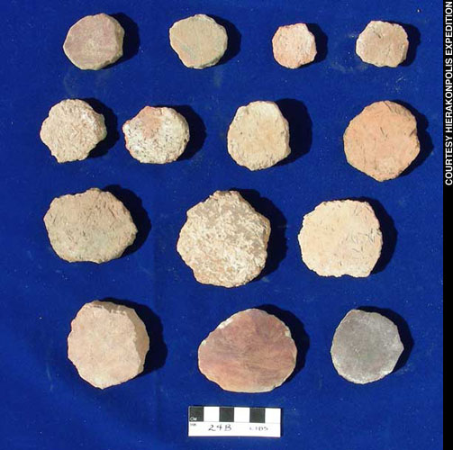
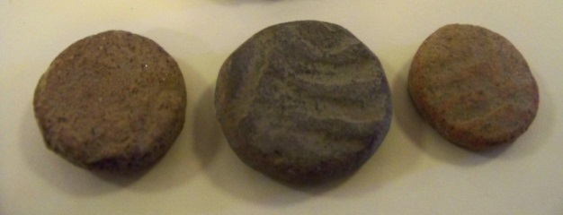
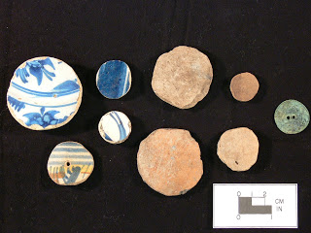
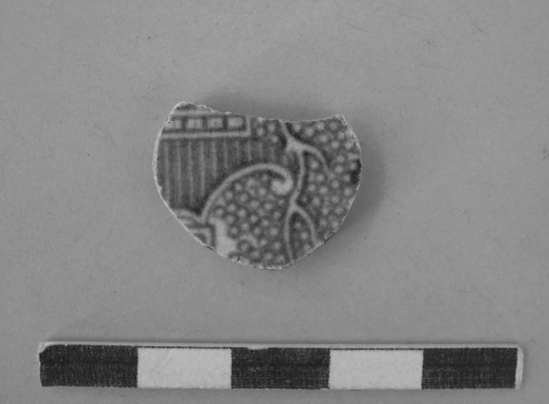
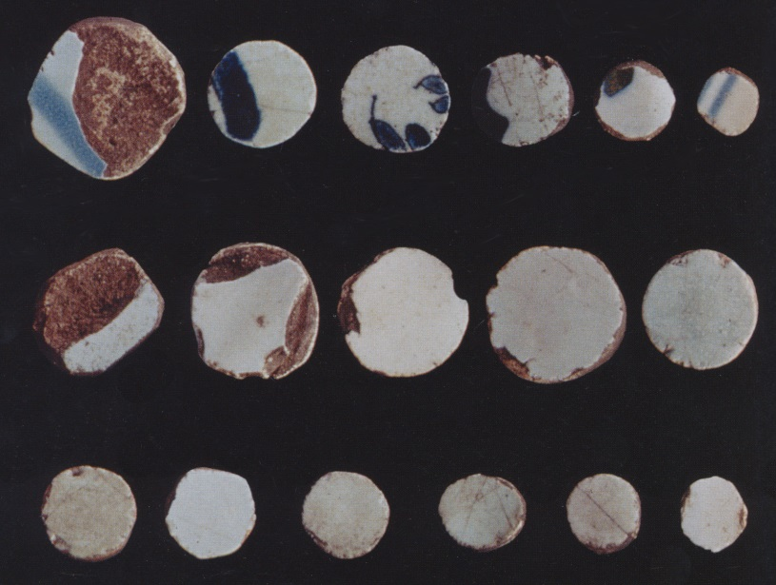
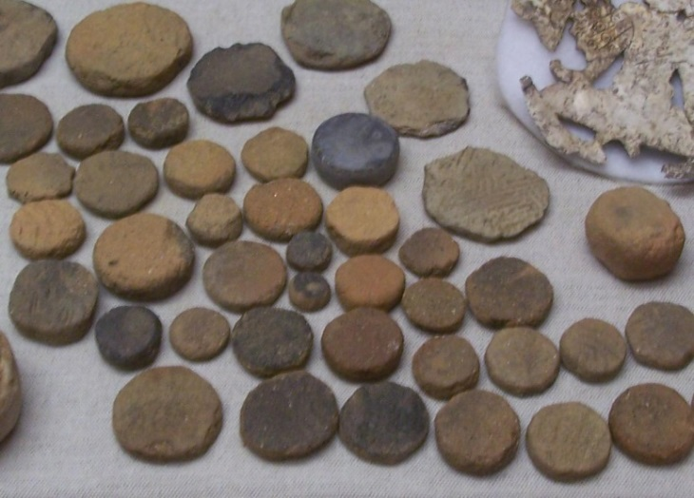
Carved Discs in Archaeological Assemblages
Swift Creek¹
Contact Period Pennsylvania²
Hierakonpolis, Predynastic Egypt
(Geller 2009)
1880s Cape Town,
South Africa
(Jordan 2005)
Contact Period Illinois (Walthall 2005)
Etowah Mounds¹
¹https://peachstatearchaeologicalsociety.org/index.php/22-game-stones/145-ceramic-discoidals
²http://twipa.blogspot.com/2010/04/ceramic-disks-childrens-play-and-adult.html

Slide 3
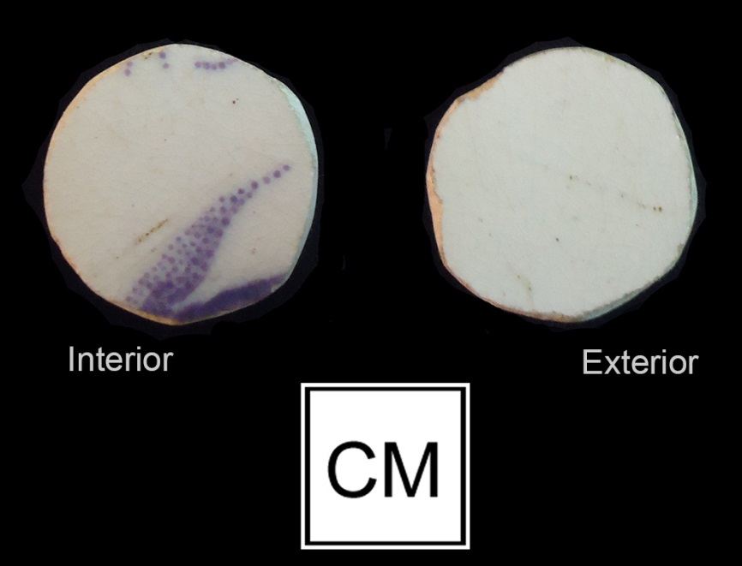
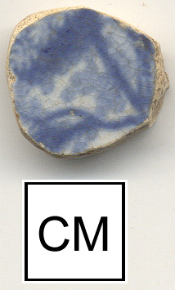
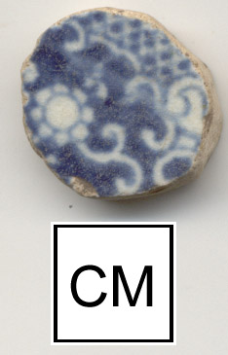
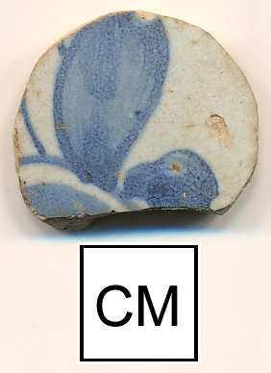
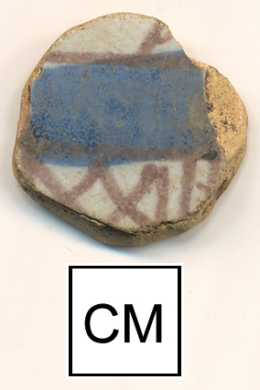
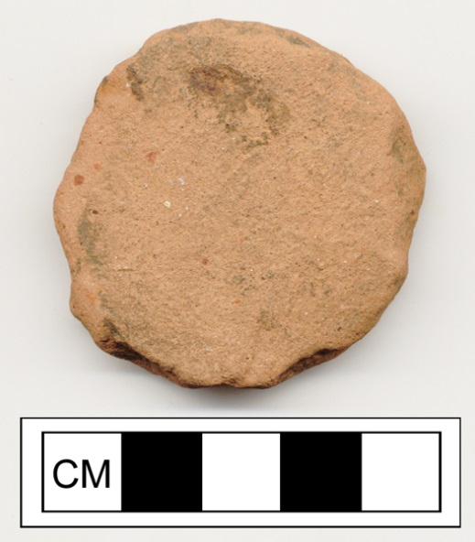
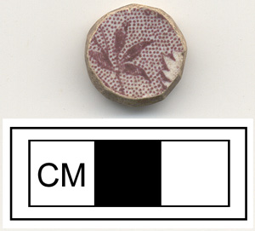
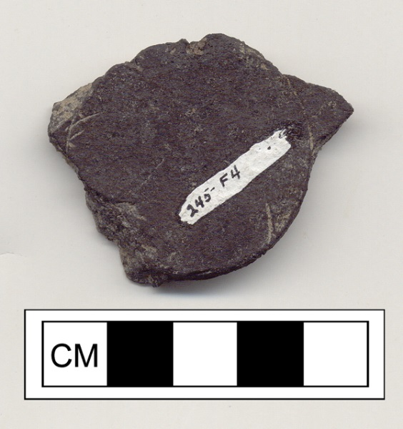
Historic Period ceramic discs from sites in DAACS
Notes:
Slide 2: Historic Period ceramic discs

Slide 4
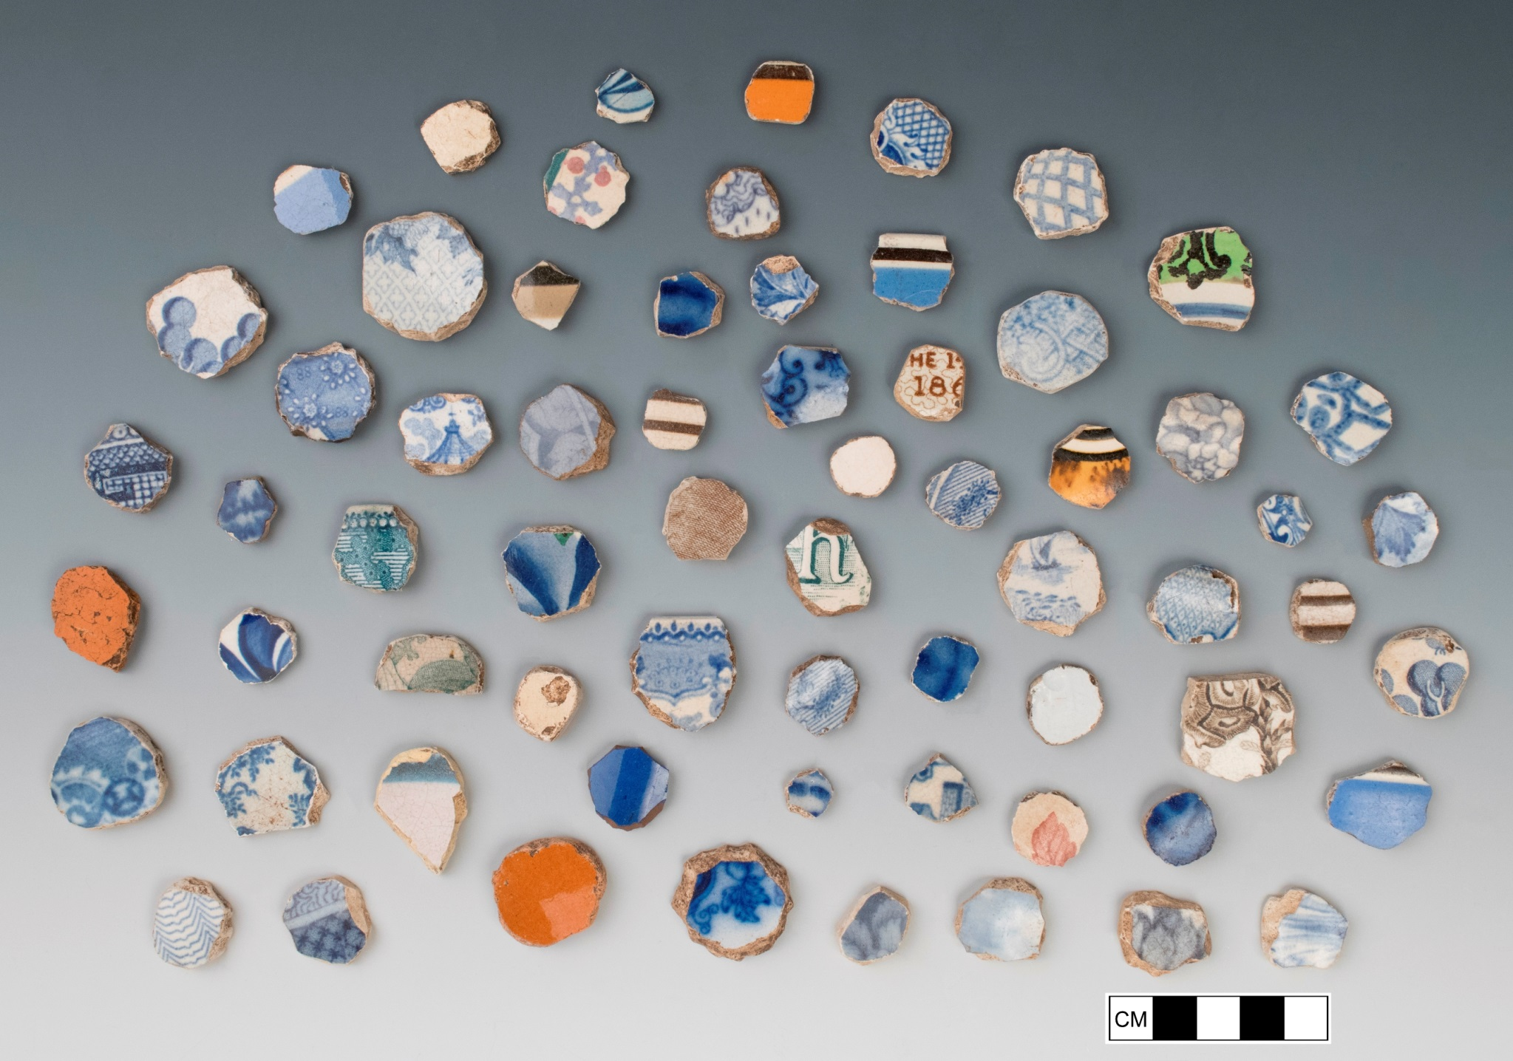
Morne Patate Gaming Pieces

Slide 5
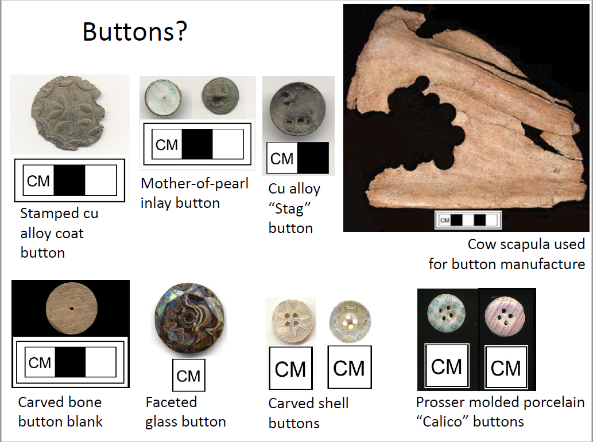
Buttons?

Slide 6
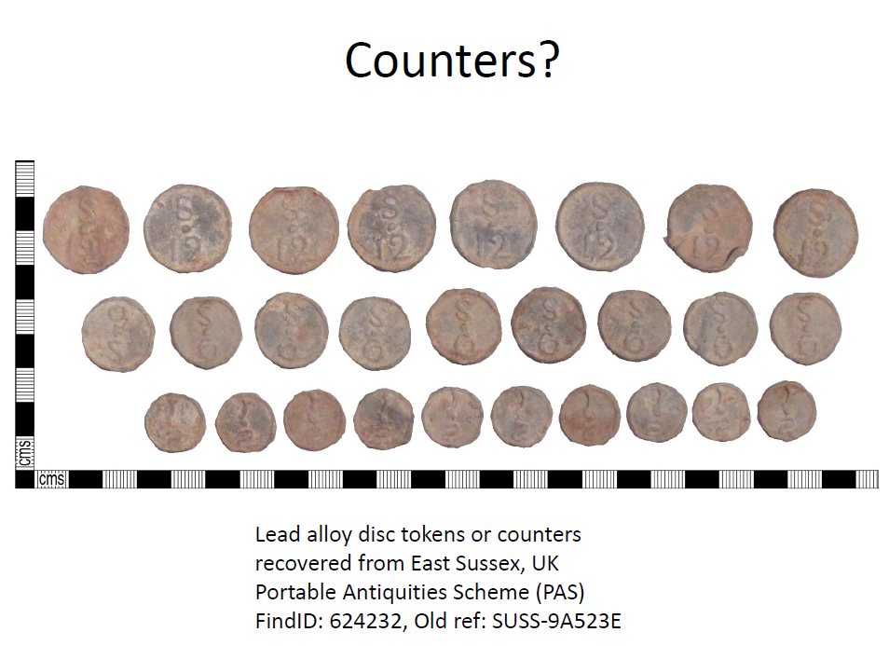
Counters?

Slide 7
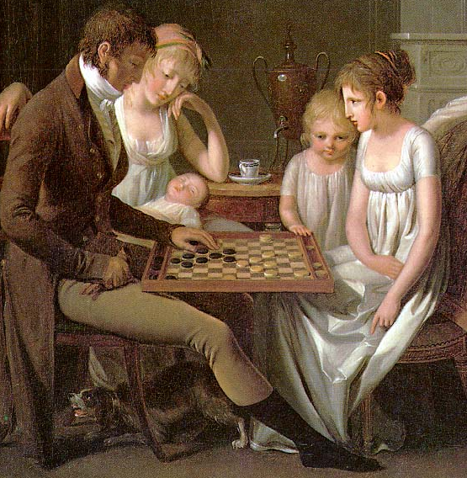
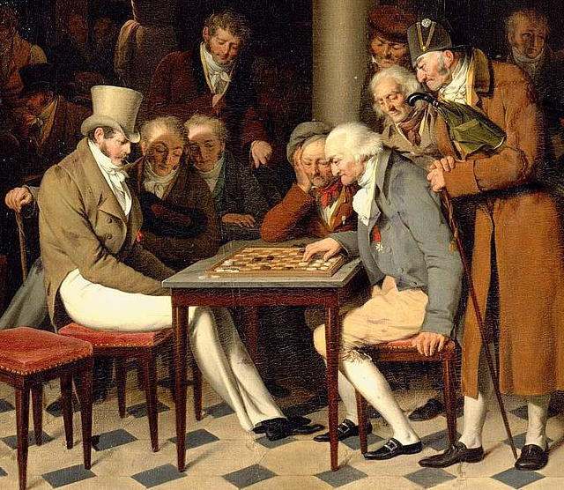
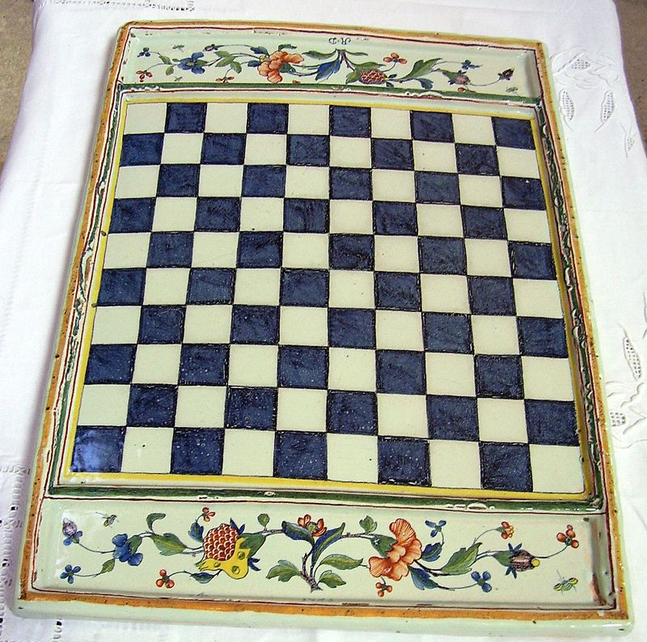
Gaming Pieces?
Wikimedia Commons Images
Faience (Rouen) Game Board

Slide 8
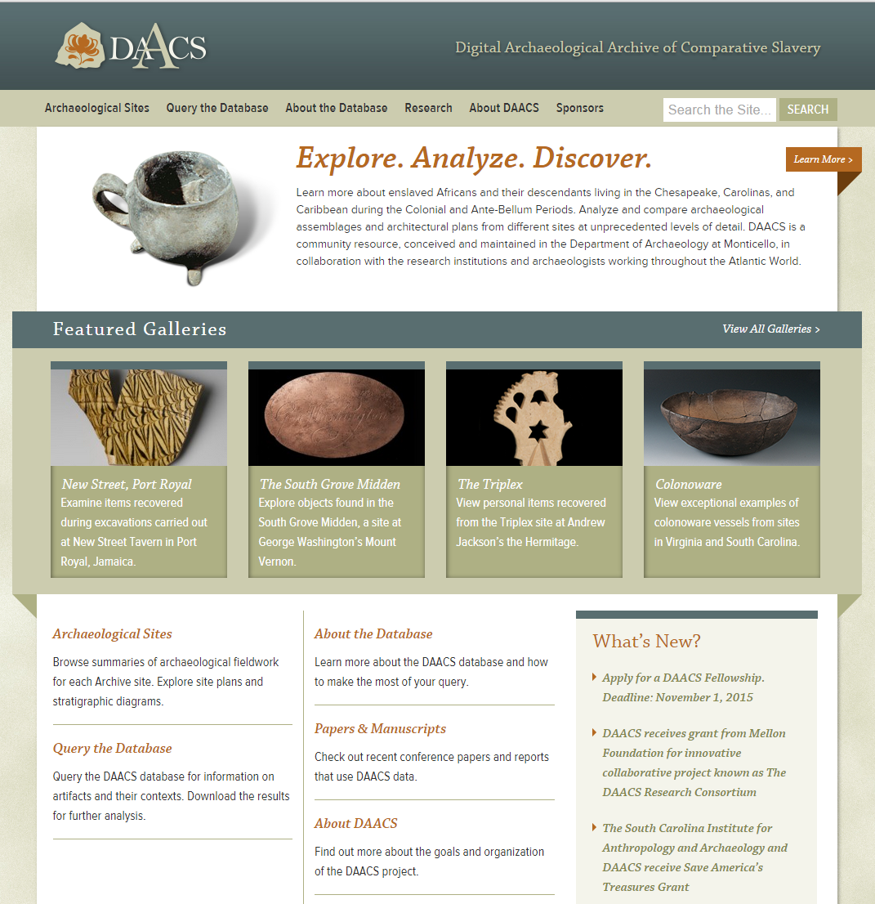
www.
daacs
.org

Slide 9
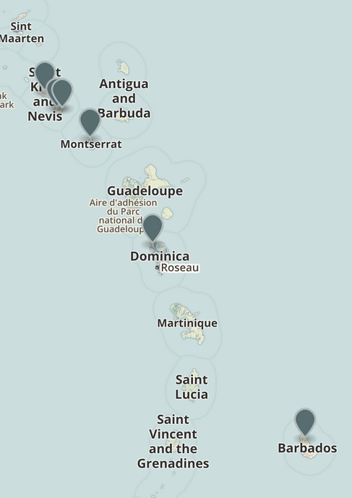
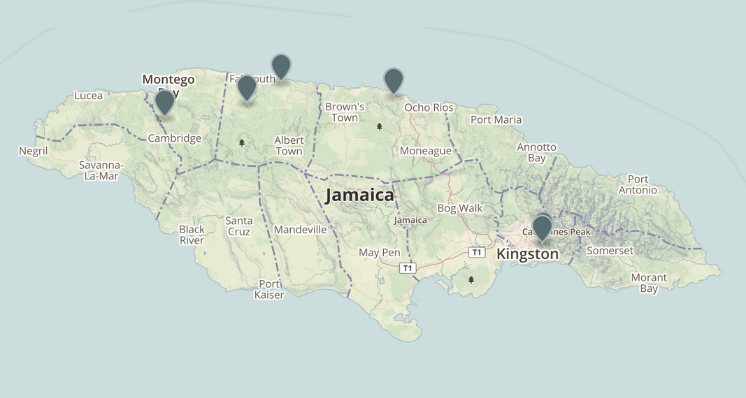
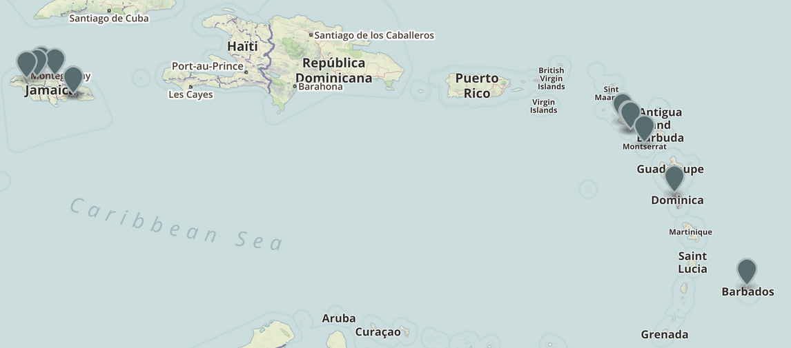
Caribbean Sites in DAACS
Notes:
Caribbean map with sites on it

Slide 10
Artifact Abundance Index
Artifact Class 1
AI =
Artifact Class 1 + Artifact Class 2
Ceramic Discs
AI =
Ceramic Discs + Wine Bottle Sherds

Slide 11
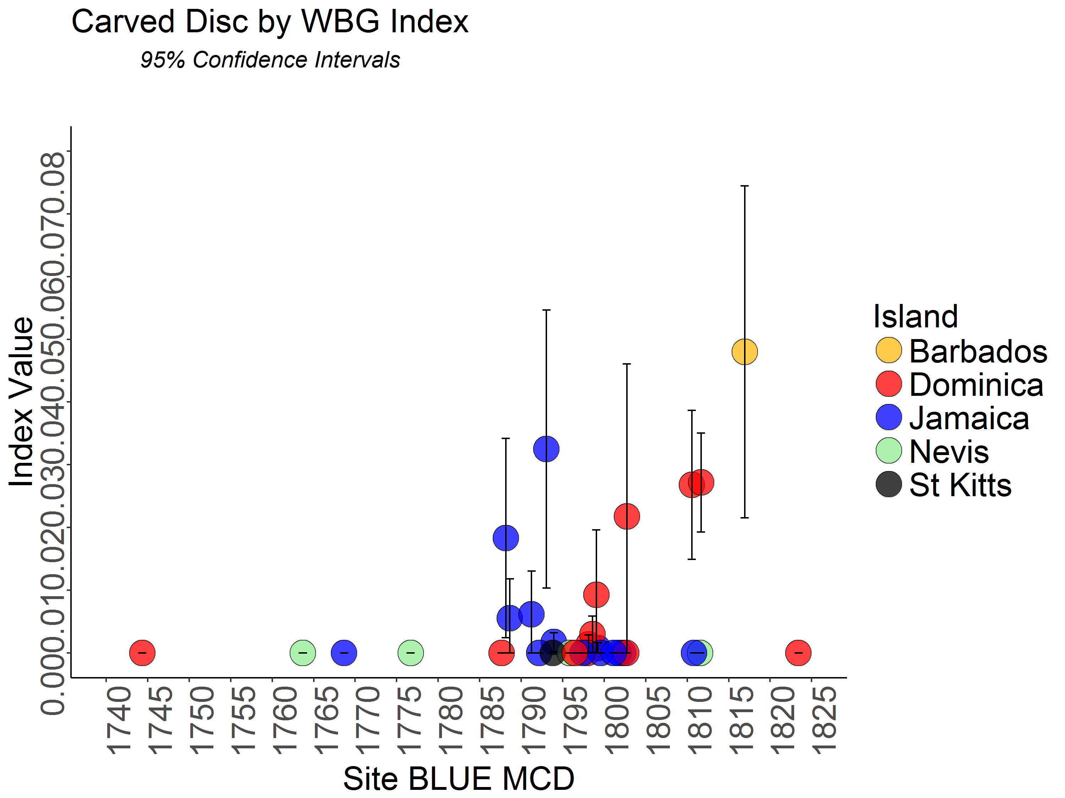

Slide 12
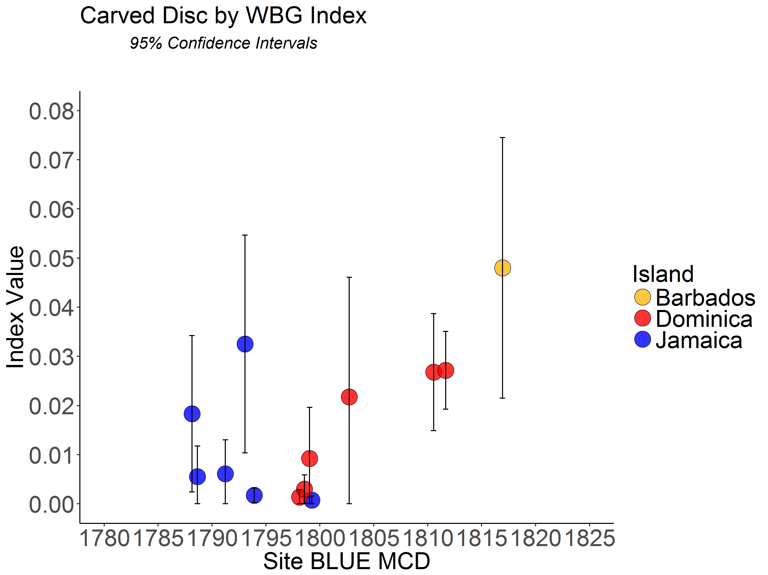

Slide 13
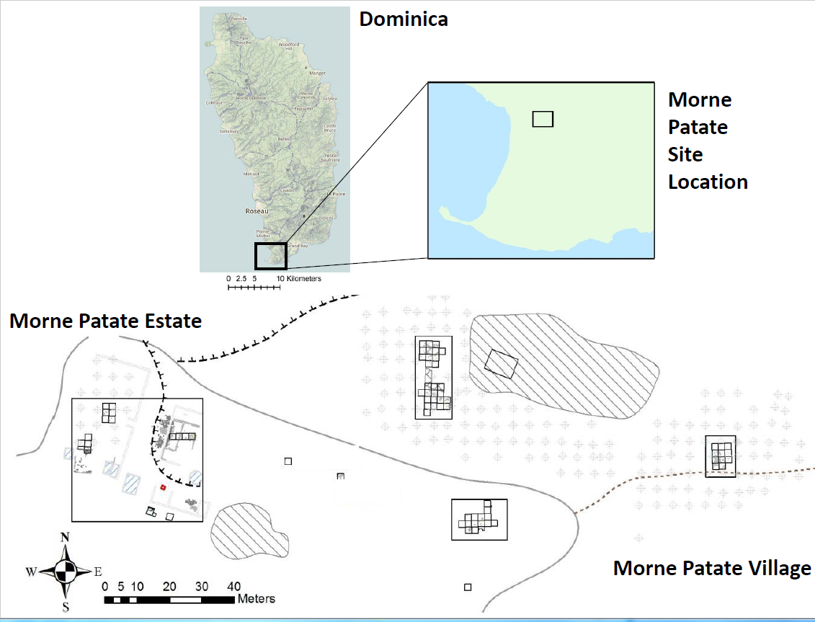

Slide 14
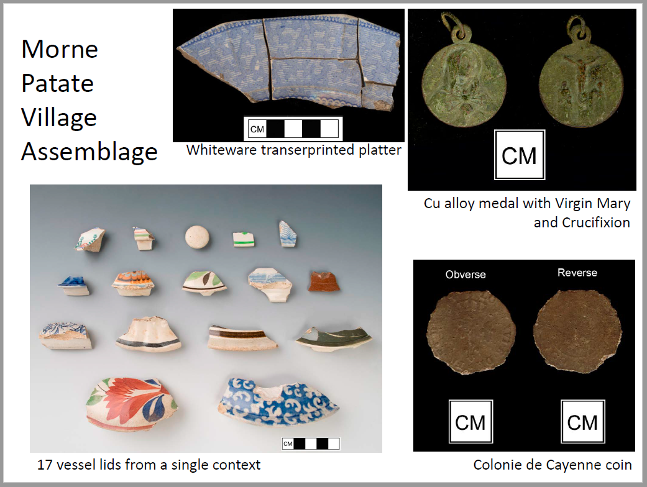

Slide 15
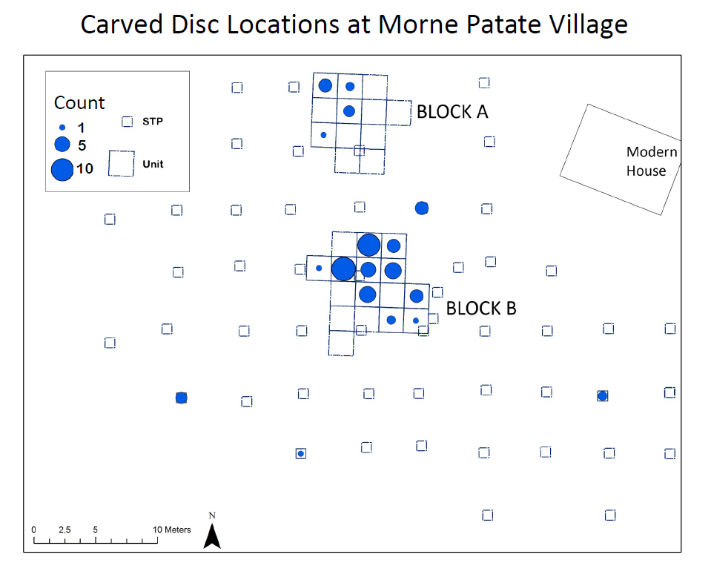

Slide 16
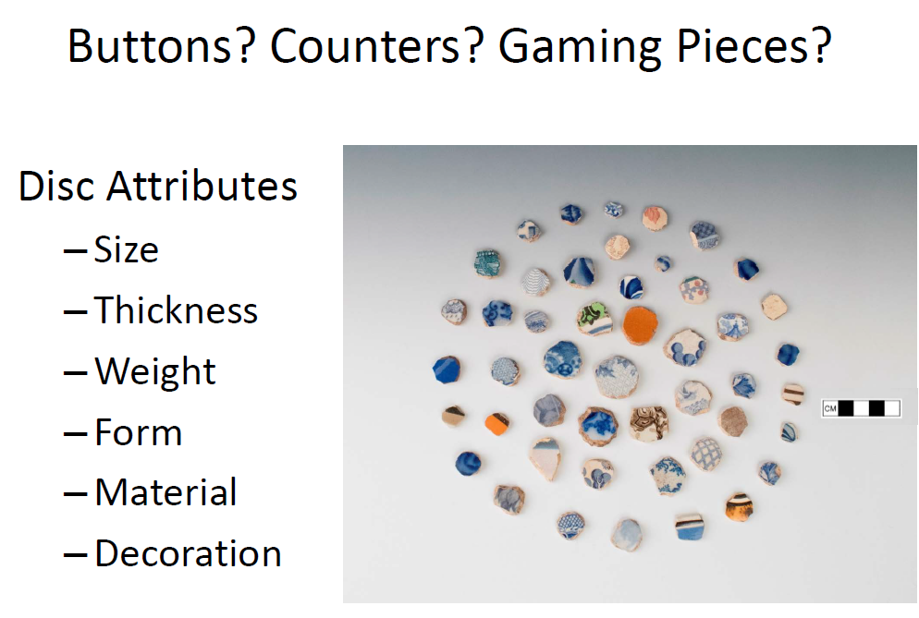

Slide 17
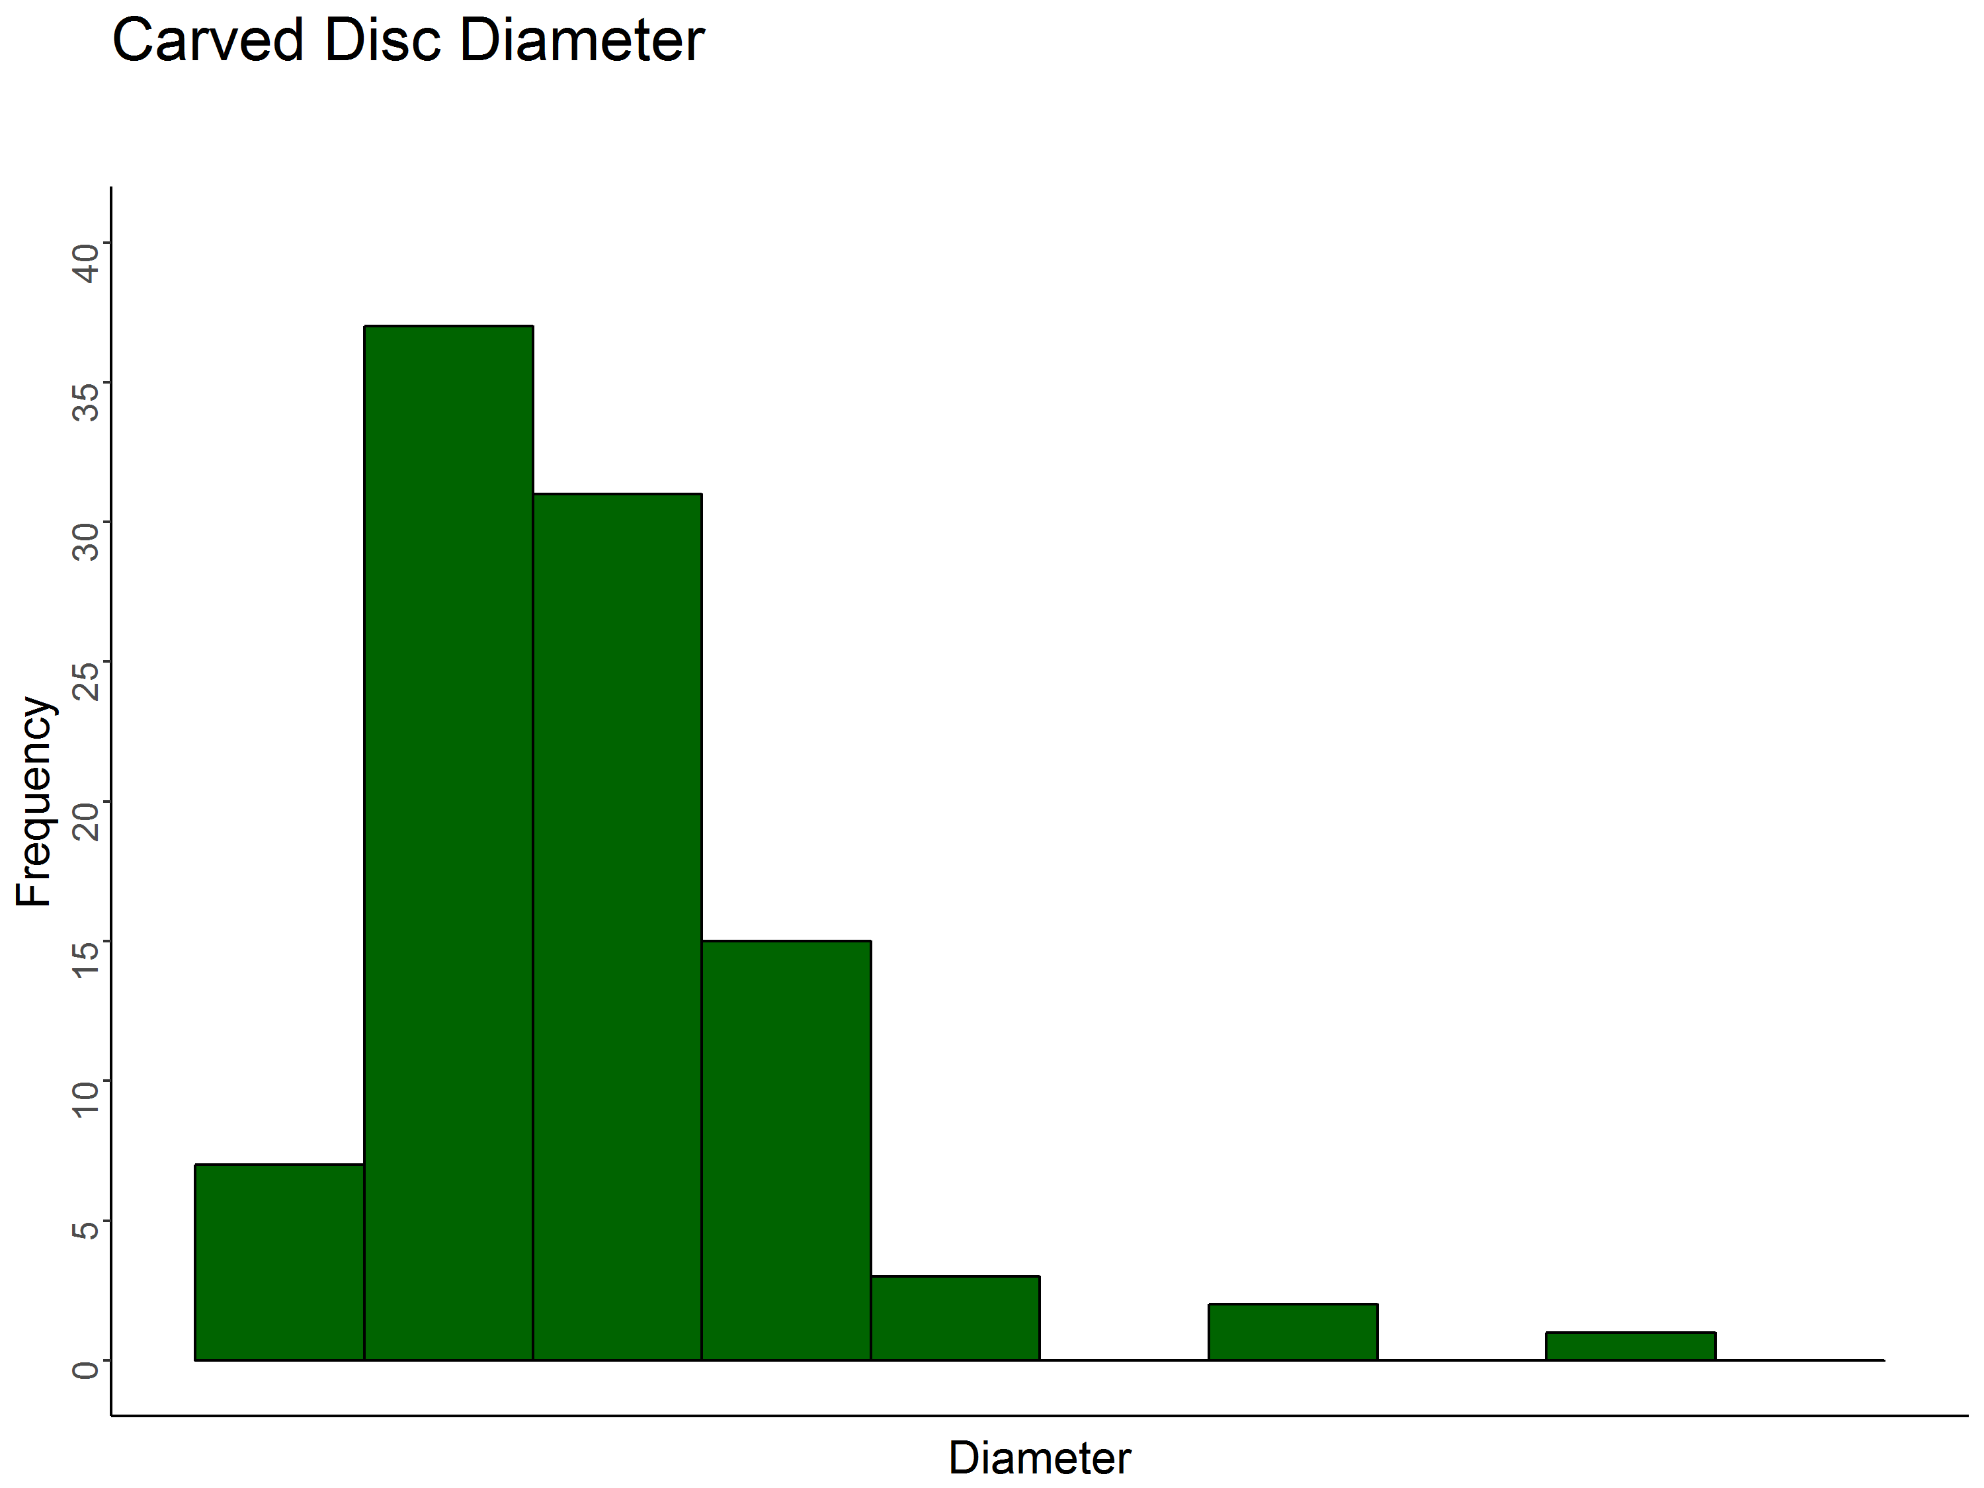
Carved Disc Diameter (mm) Histogram
15
20
25
10
30
40
50

Slide 18
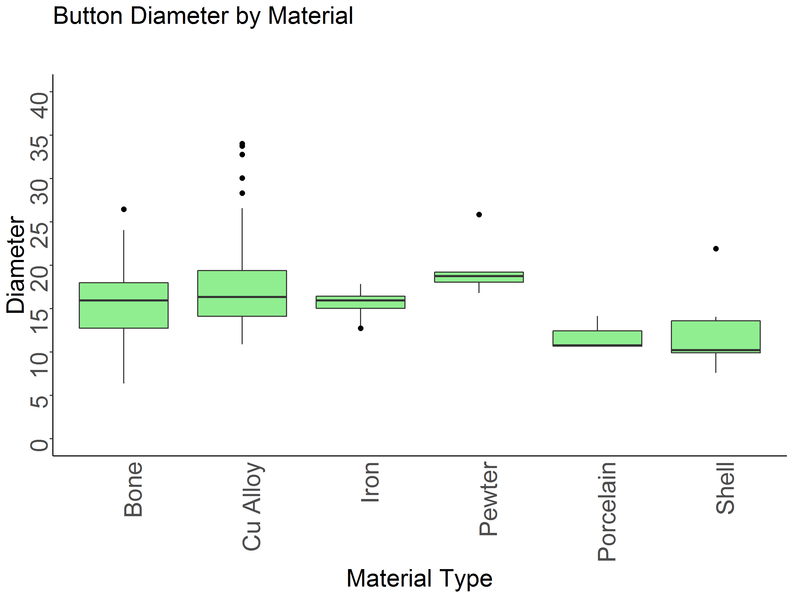
Caribbean Button Diameter by Material
Caribbean Carved Disc Diameter 24.2 mm

Slide 19
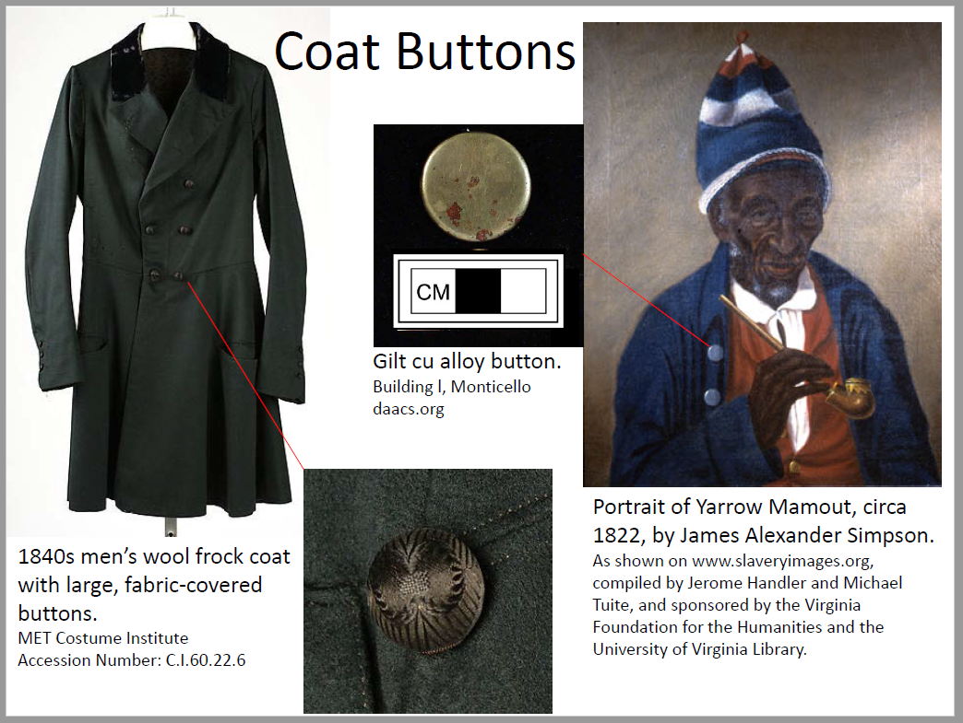

Slide 20
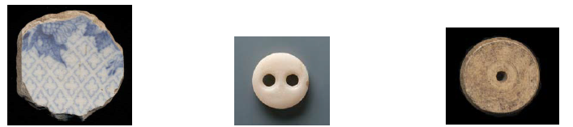
Comparison of Mean Measurements (mm)
from Caribbean sites in DAACS
 | All Buttons n=231 | Button Blanks n=29 | Ceramic Discs n=76
Avg. Diameter | 16.39 | 15.84 | 24.17
Avg. Thickness | 2.09 | 1.72 | 4.77
Avg. Weight | 1.47 | 0.40 | 2.84
Notes:
Mean diameter 16.3925; Mean height 2.089006; Mean weight 1.472105
Blanks diam 15.83815; Blanks height 1.719583; Blanks weight 0.4037037

Slide 21
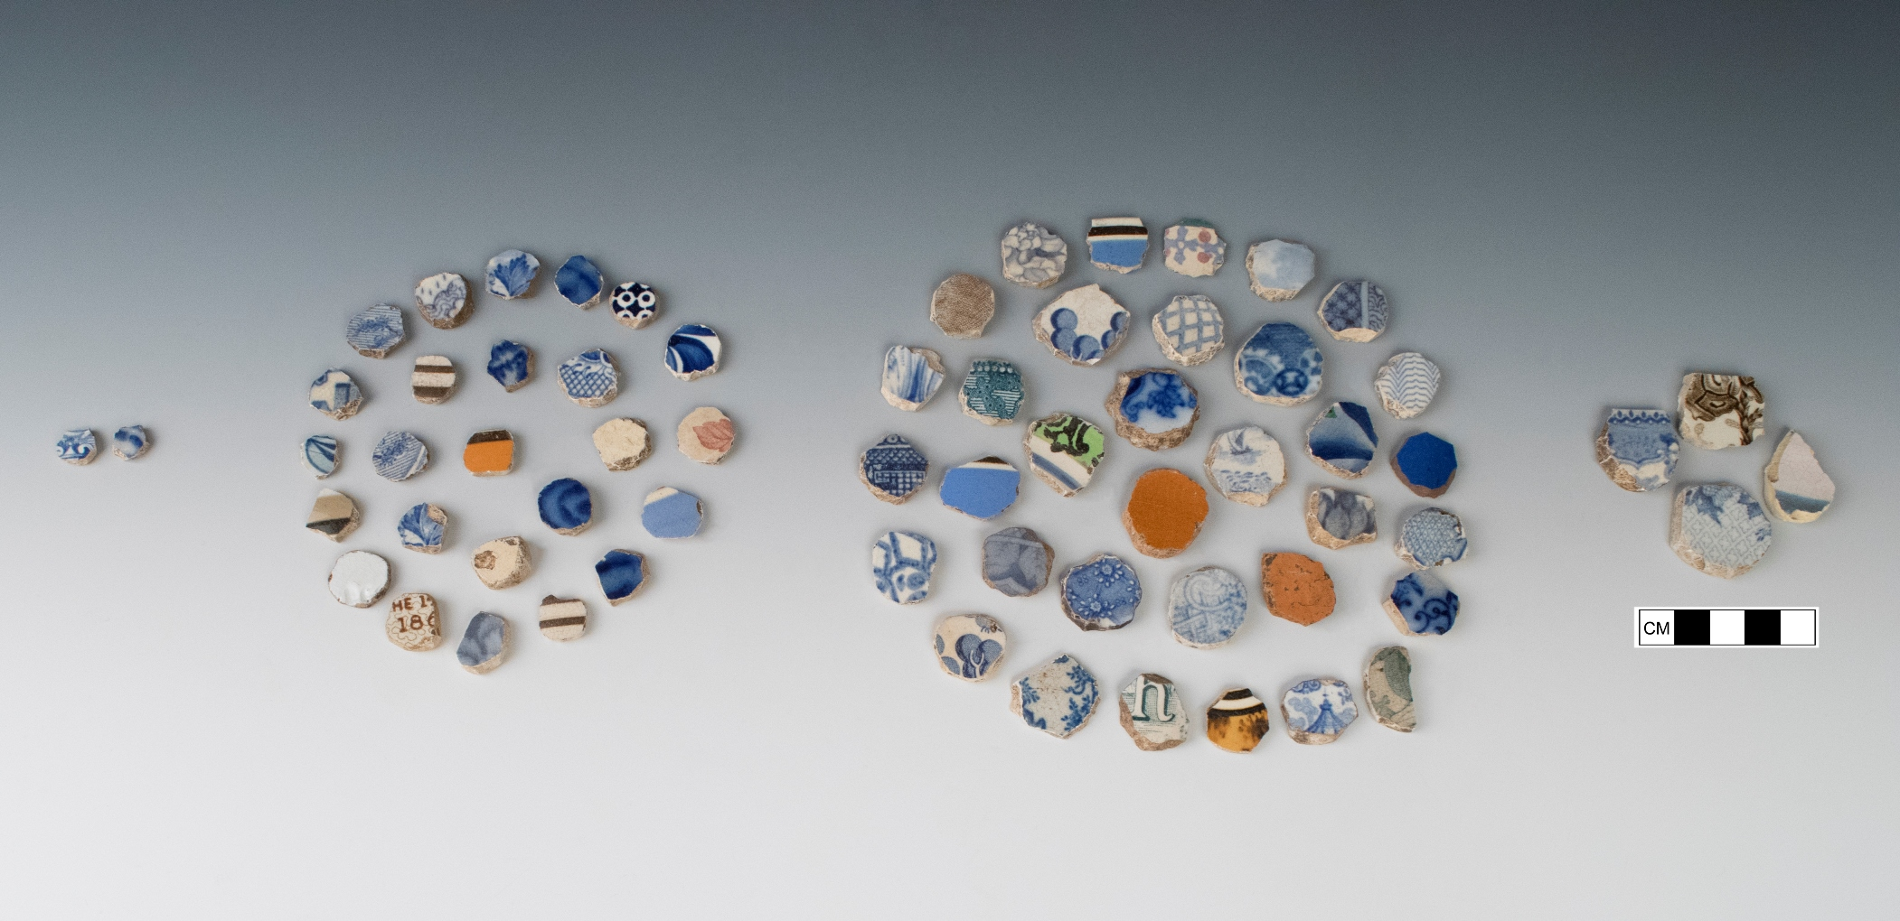
Max. Diameter of Carved Discs at Morne Patate
10 mm
~ 20 mm
> 40 mm
~ 30 mm

Slide 22
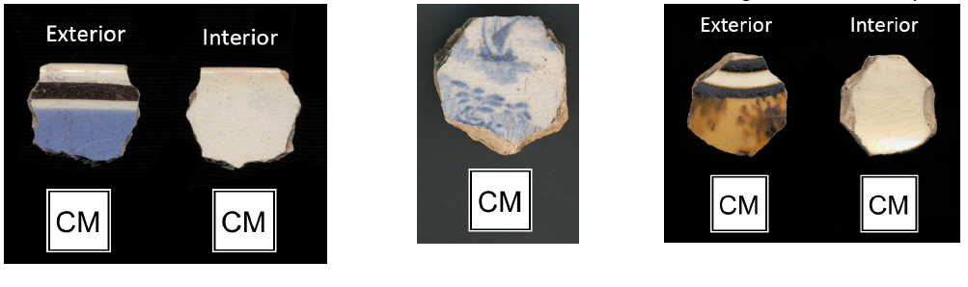
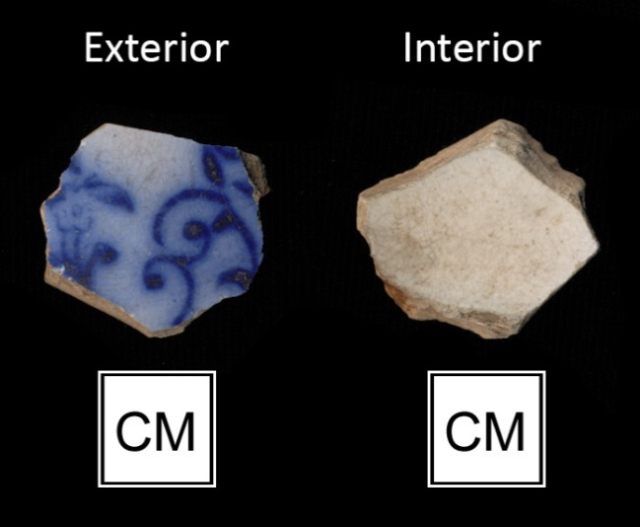
Forms of Caribbean Carved Discs
Hollow “Body, rim”
Flat “Base, body”
Hollow Lid
Hollow
Body
Vessel Type | Percentage
Flat | 36.3
Hollow | 34.3
Unidentifiable | 29.4

Slide 23
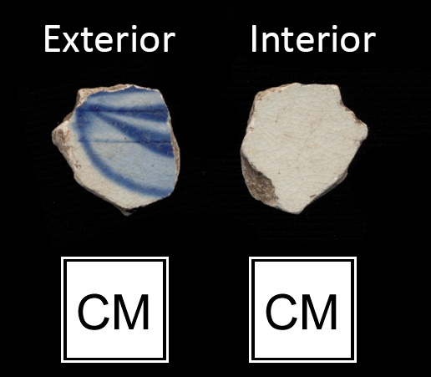
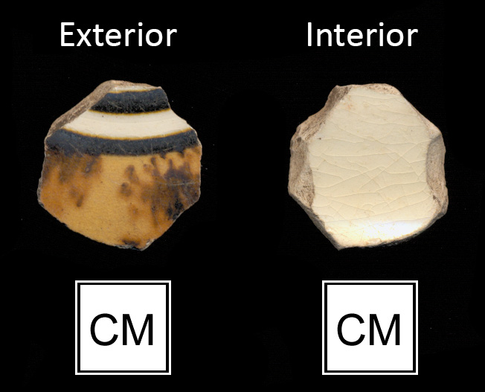
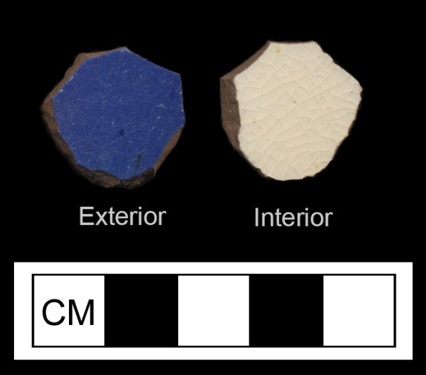
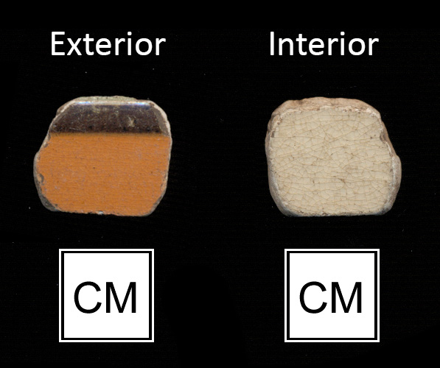
Sample of Carved Discs from Hollow Vessels at Morne Patate Village

Slide 24
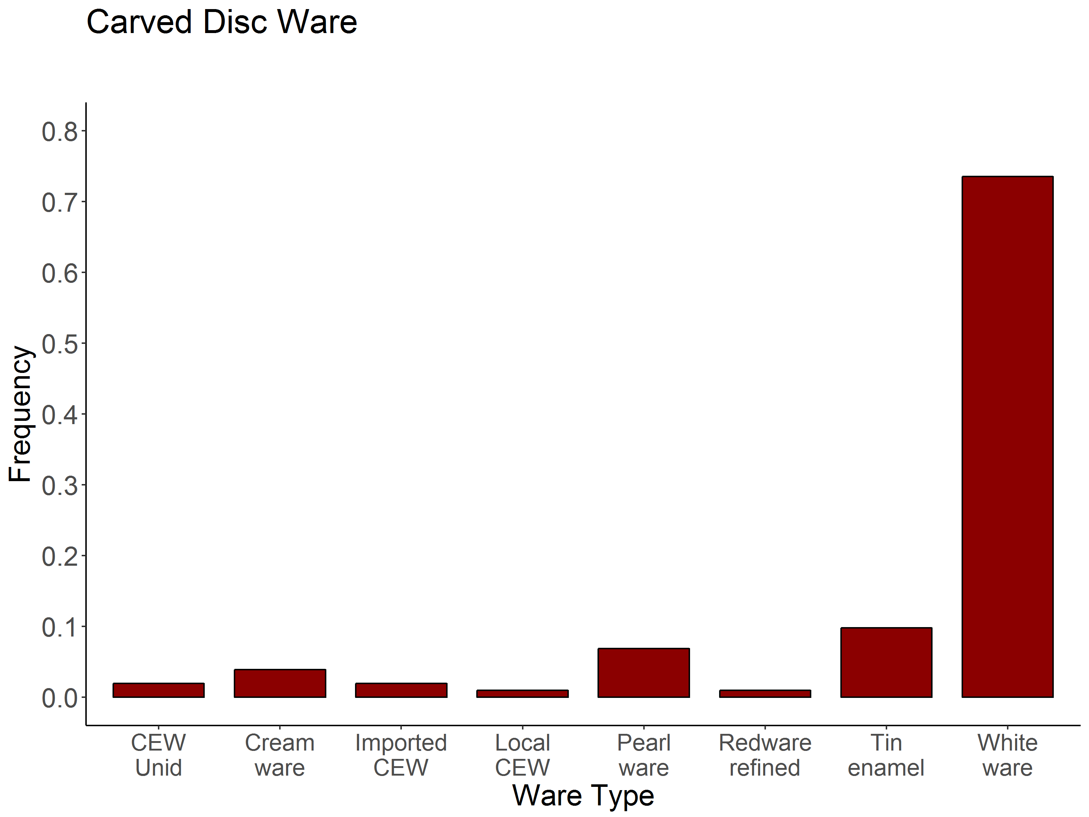
Caribbean Carved Disc Frequency by Ware Type
0.73
0.10
0.07
0.02
0.04
0.02
0.01
0.01
Notes:
Coarse EW 5, Refined EW 97

Slide 25
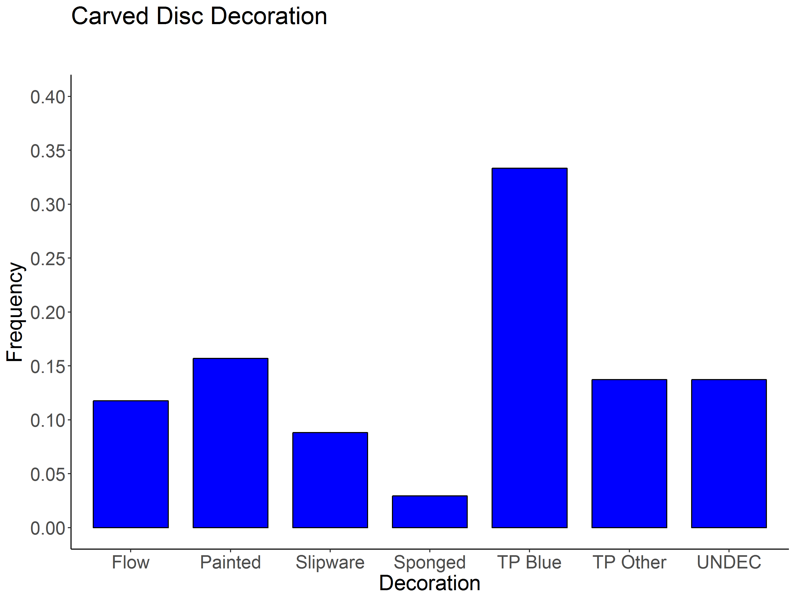
Caribbean Carved Disc Frequency by Decoration
Transferprint
= 47%
0.33
0.16
0.14
0.14
0.12
0.09
0.03

Slide 26
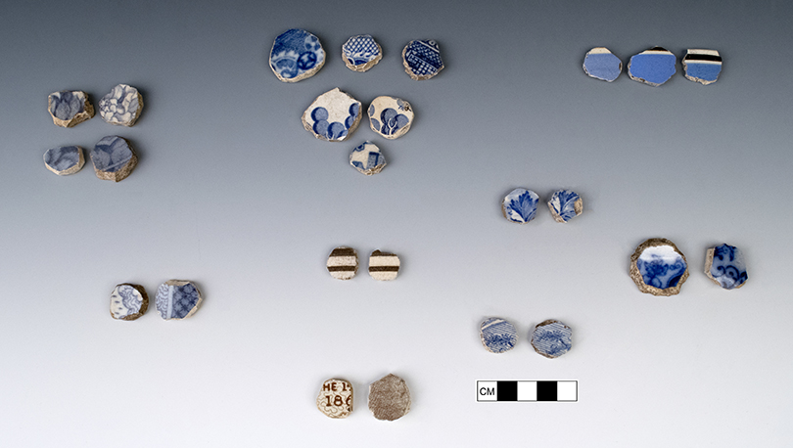
Morne Patate: Multiple Discs from Similar Vessels

Slide 27
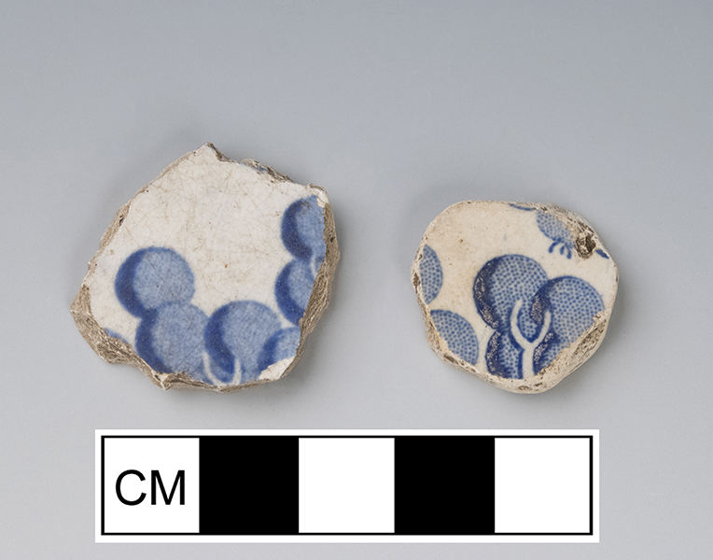
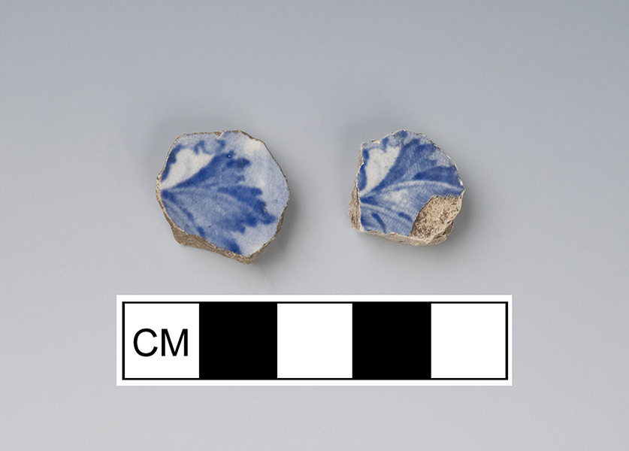
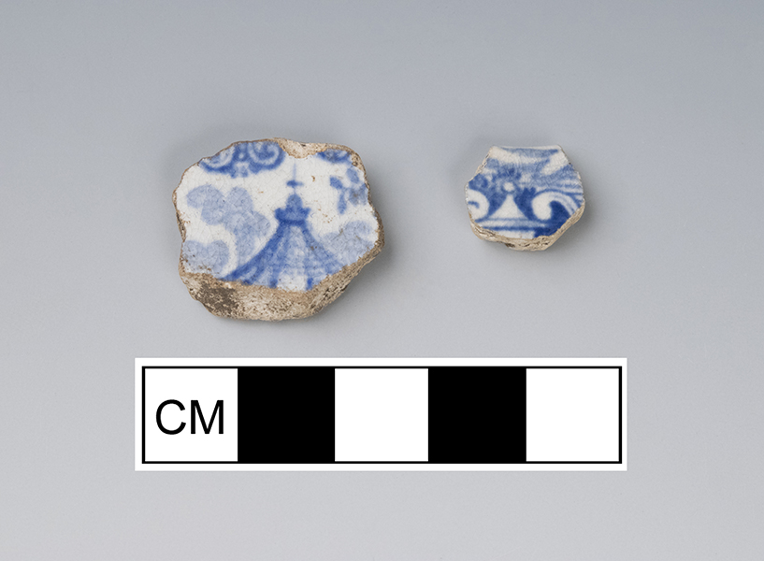
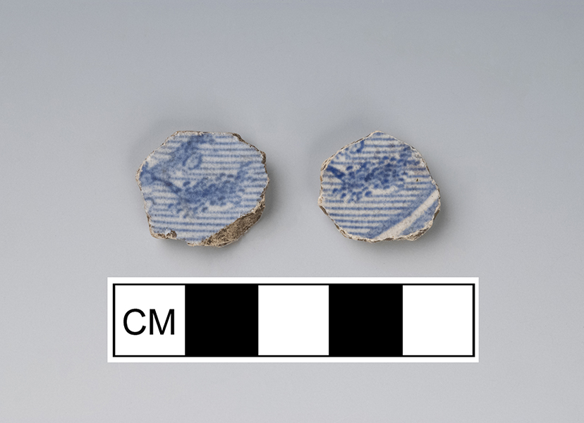
Morne Patate: Selection for Specific Stylistic Elements?
Willow Trees
Leaves
Pyramid-shape

Slide 28
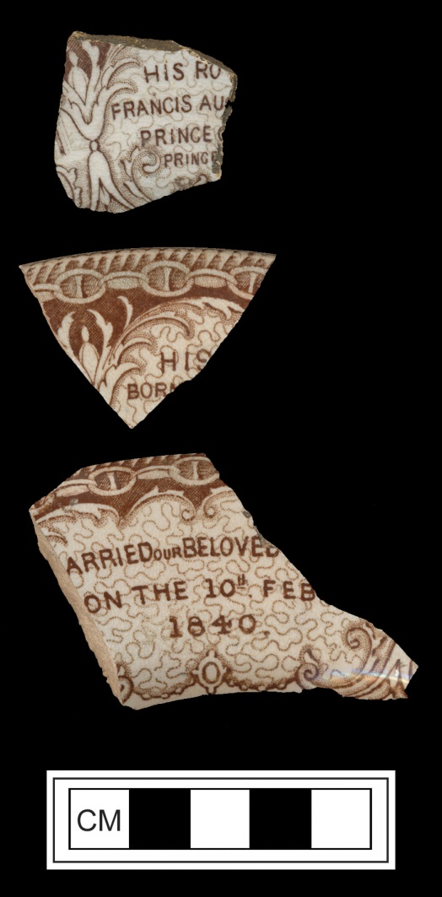
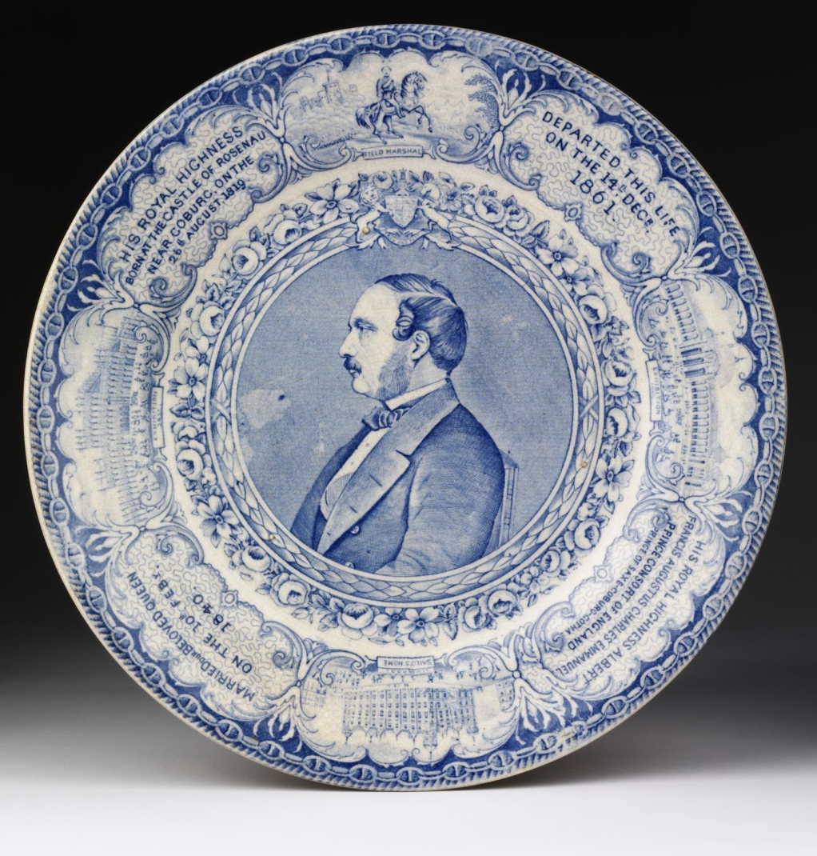


Prince Albert Commemorative Plate c. 1862 Morne Patate Block B
Plate image: http://collections.vam.ac.uk/item/O225536/plate-close-jt/
Notes:
Add sherds

Slide 29


Side 1: Decorated or Glazed (CEW)
Side 2: Undecorated or Unglazed (CEW)

Slide 30

Manufacturing Evidence
of Carved Discs at Morne Patate
“Preform”
Several Flat Sides
Notched Shape from Rounding
Smooth, Worn Edges

Slide 31
Jonathan Troupe August 1789, Dominica
“The New Negroes sometimes fall to play they have a Board wt No. of hollows in it & they pass from one hole to another a No. of small peebles so quick & they are so successful some of them that it surprises passengers to see them but they cant […] & it is done so quickly that one cant understand it—They will take pieces of bottles & stone ware & toss them up after they have rapidly mixt them from hand to hand & in this way gain plantanes”
Quotation courtesy of Mark W. Hauser, Northwestern University

Slide 32
Thomas Hearne, 1775. A View On the Island of Antigua: The English Barracks and Saint John's Church Seen From the Hospital. Yale Center for British Art, Paul Mellon Collection

Slide 33
Thomas Hearne, 1775. A View On the Island of Antigua: The English Barracks and Saint John's Church Seen From the Hospital. Yale Center for British Art, Paul Mellon Collection

Slide 34

Chronology of Contexts
Phase 04
n=18
Phase 03
n=3
Phase 01
n=2

Slide 35
Conclusions
Quantity of Discs at Morne Patate
Small scale production possibly for sale, though also evidence of use
Majority of discs across DAACS Caribbean sites are whiteware
Possible increase in gaming culture and/or leisure time after Emancipation
Predominant presence of decoration or glaze on one surface
Suggests use of discs in game with “heads and tails”
Selection for specific types of decoration

Slide 36


Thank You!
Dr. Suzanne Francis-Brown, Dr. Zachary Beier, Dr. James Robertson, and the ASJ Board
University of the West Indies, Mona
Jamaica National Heritage Trust, Archaeology Division
Dr. Jessica MacLean, Dr. Lindsay Bloch, Dr. Fraser Neiman, Ms. Leslie Cooper, Dr. Beth Bollwerk, Mr. and Mrs. Simon Walsh
Morne Patate Gaming Piece Images by Mrs. Katelyn Coughlan (Monticello Archaeology)
Many thanks to Jamaican, Bajan, and Dominican field crews for excavating the sites!

